Slide 1
Computer Vision and Deep Learning for Construction Site Anomaly Behavior Detection
MEMBERS:
Abishek S (9517202109005)
Mohamed Aslam K (9517202109034)
GUIDE: Dr. P.Swathika , PhD, (AP(Sr.G))
Department of Artificial Intelligence and Data Science
Mepco Schlenk Engineering College

Slide 2
Aim
To develop a construction site anomaly detection system.
It should be robust to find all the anomaly behavior (Crowding over pit, working on top of the building with out safety gadgets etc..)

Slide 3
Objective
To enhance detection accuracy by integrating cross-attention between image features and safety rule embeddings.
To utilize Faster R-CNN for extracting image features for safety monitoring.
To integrate a GRU network for embedding safety rules effectively.

Slide 4
Requirement Analysis
Checking for anomaly behavior using Faster-R-CNN
If any anomaly behavior detected site supervisor is notified

Slide 5
Literature Survey
Reference | Model | Dataset | Significant Factor | Evaluation Measures
Chorowski, J., Bahdanau, D., Serdyuk, D., Cho, K., & Bengio, Y. (2015). | Attention-Based Recurrent Neural Network(RNN) model | TIMIT Phoneme Recognition Dataset | Location-aware attention mechanism | Phoneme Error Rate (PER)
Fang, Q., Li, H., Luo, X., Ding, L., Luo, H., Rose, T. M., & An, W. (2018) | Faster R-CNN (Region-Convolutional Neural Network) | More than 100,000 image frames from surveillance videos of construction sites​ | Location-aware attention mechanism | Precision: 90.4 Recall : 91.5
Cho, K., van Merrienboer, B., Gulcehre, C., Bahdanau, D., Bougares, F., Schwenk, H., & Bengio, Y. (2014) | RNN Encoder-Decoder architecture | WMT’14 translation Dataset | Novel hidden unit | BLEU scores of 34.64 on the test set compared to 33.30 for the baseline model​
Ben-Alon, L., & Sacks, R. (2017) | Agent-Based Simulation (ABS) combined with Building Information Modeling (BIM) | High-rise residential construction dataset. | Economic utility model | F1-Score:84.3
Waehrer, G. M., Dong, X. S., Miller, T., Haile, E., & Men, Y. (2007). | Comprehensive cost model | the Bureau of Labor Statistics (BLS) dataset. | Quality of life costs | Accuracy:80.5

Slide 6
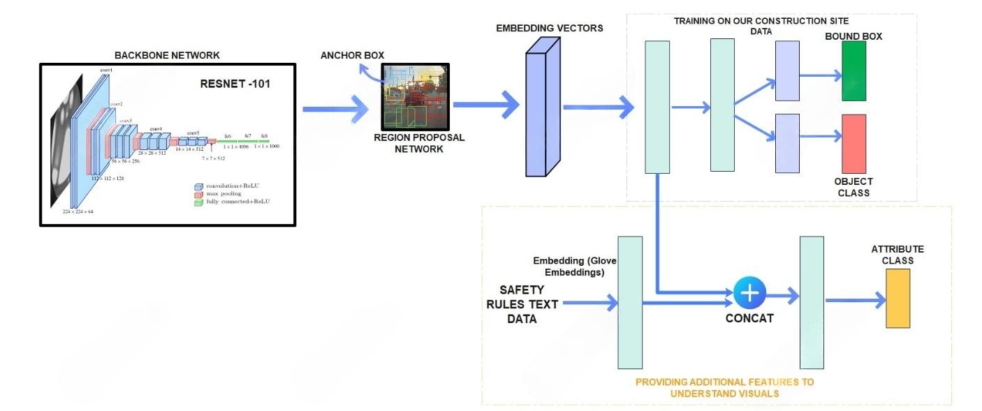
System Design

Slide 7
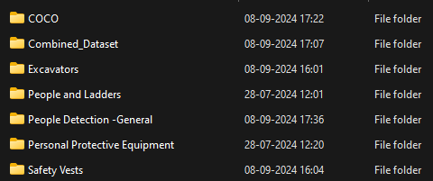
DATASET
Custom dataset which is pipelined from various sources combined to form single dataset with 193,000.
It consists of combination of all data

Slide 8
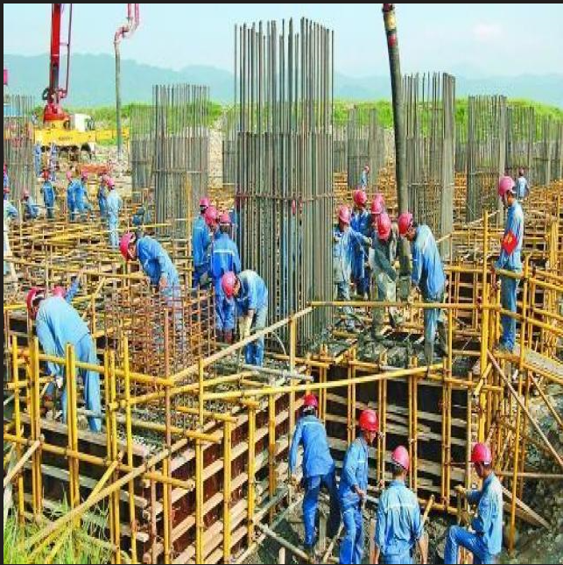
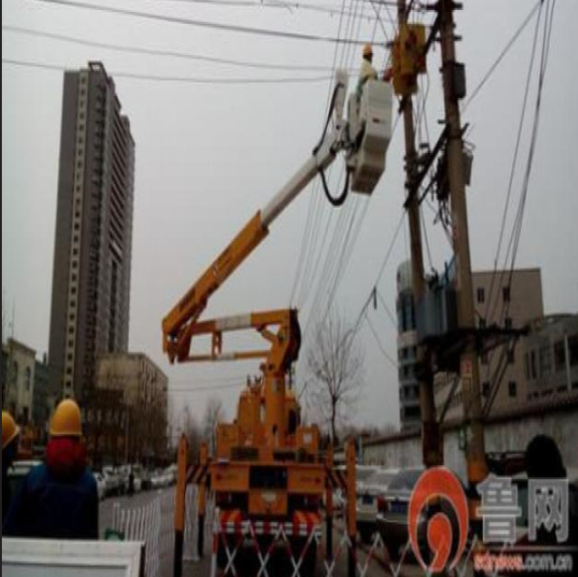
DATASET

Slide 9
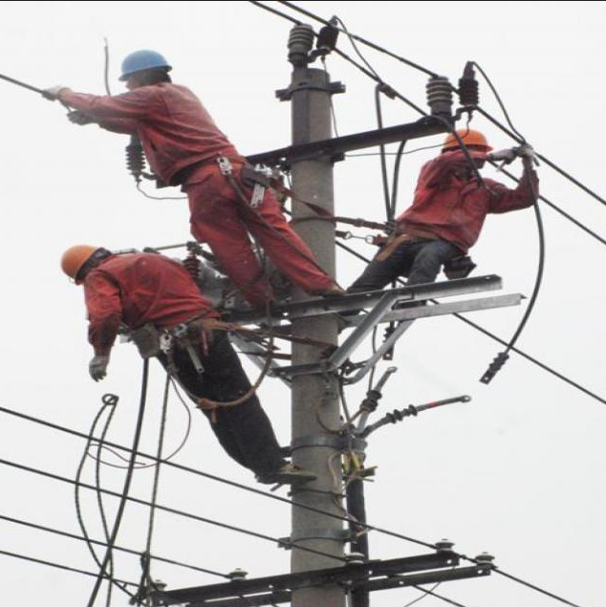
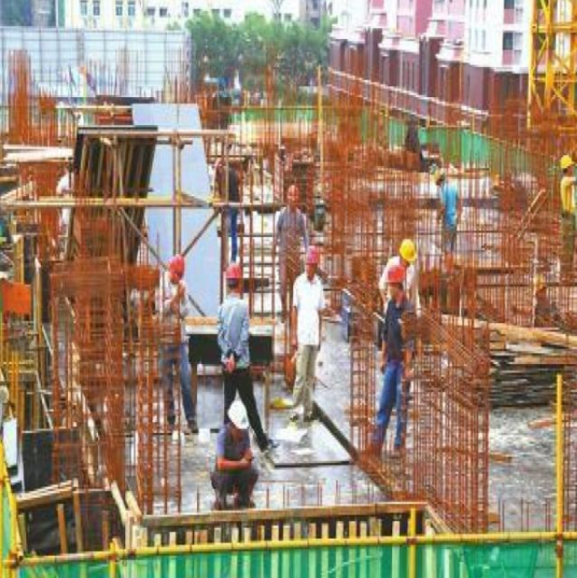
DATASET

Slide 10
Pre Processing
Combination of image datasets and classes
Dataset from multiple sources must be combined.
All the labels from each dataset must be mapped according to data combination.

Slide 11
Pre Processing ( Contd…)
Splitting of test train images
The MS-COCO dataset does not include test images.
We need to extract the test data from the training images along with their labels, create a new folder for the test data, and then remove those images from the training set.

Slide 12
Pre Processing ( Contd…)
Image Preprocessing: Resizing, Tensor Conversion, and Normalization
Image Resizing: Adjusts images to a fixed size to ensure compatibility with the model's input dimensions.
Image-to-Tensor Conversion: Converts image data into a tensor format, scaling pixel values and reordering channels as required by the model.
Normalization: Standardizes pixel values (typically between 0 and 1 or using a dataset-specific mean and standard deviation) to improve training stability and convergence.

Slide 13
Working
This work introduces a computer vision and deep learning method to match images of unsafe behavior with safety rules. This method includes:
1. Image feature representation.
2. Safety rule feature representation.
3. Feature fusion similarity to match unsafe behavior with safety rules.

Slide 14
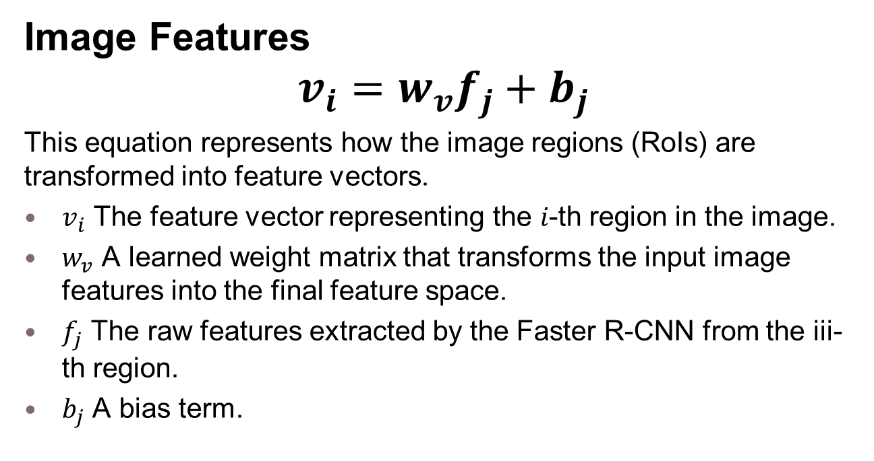
Working ( Contd…)
Image Features
$$v_{i}=w_{v}f_{j}+b_{j}$$
This equation represents how the image regions (RoIs) are transformed into feature vectors.
$v_{i}$ The feature vector representing the 𝑖-th region in the image.
$w_{v}$ A learned weight matrix that transforms the input image features into the final feature space.
$f_{j}$ The raw features extracted by the Faster R-CNN from the iii-th region.
$b_{j}$ A bias term.

Slide 15
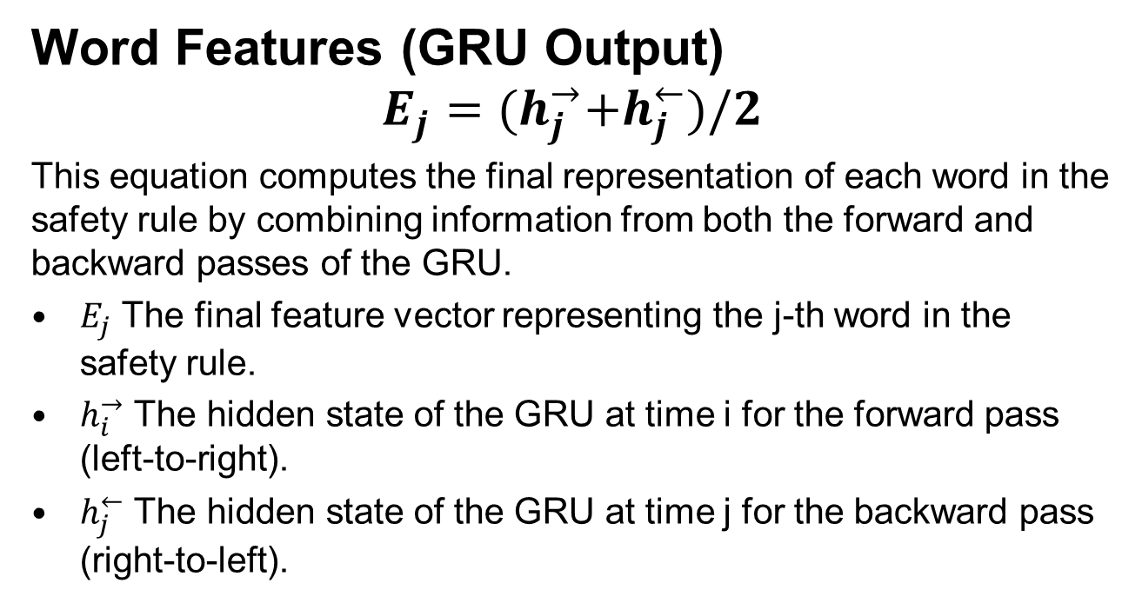
Working ( Contd…)
Word Features (GRU Output)
$$E_{j}={(h}_{j}^{→}+h_{j}^{←})/2$$
This equation computes the final representation of each word in the safety rule by combining information from both the forward and backward passes of the GRU.
$E_{j}$ The final feature vector representing the j-th word in the safety rule.
$h_{i}^{→}$ The hidden state of the GRU at time i for the forward pass (left-to-right).
$h_{j}^{←}$ The hidden state of the GRU at time j for the backward pass (right-to-left).

Slide 16
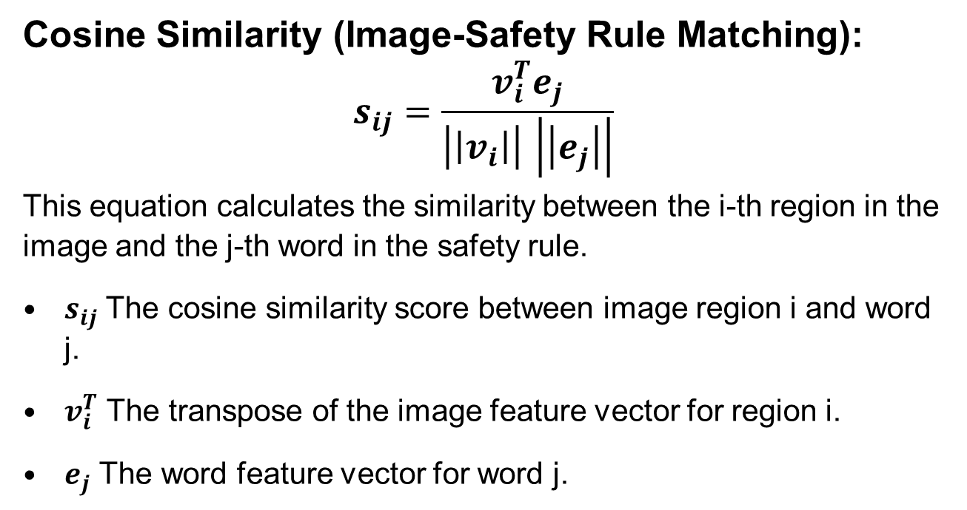
Working ( Contd…)
Cosine Similarity (Image-Safety Rule Matching):
$$s_{ij}=\frac{v_{i}^{T}e_{j}}{\left|\left|v_{i}\right|\right| \left|\left|e_{j}\right|\right|}$$
This equation calculates the similarity between the i-th region in the image and the j-th word in the safety rule.
$s_{ij}$ The cosine similarity score between image region i and word j.
$v_{i}^{T}$ The transpose of the image feature vector for region i.
$e_{j}$ The word feature vector for word j.

Slide 17
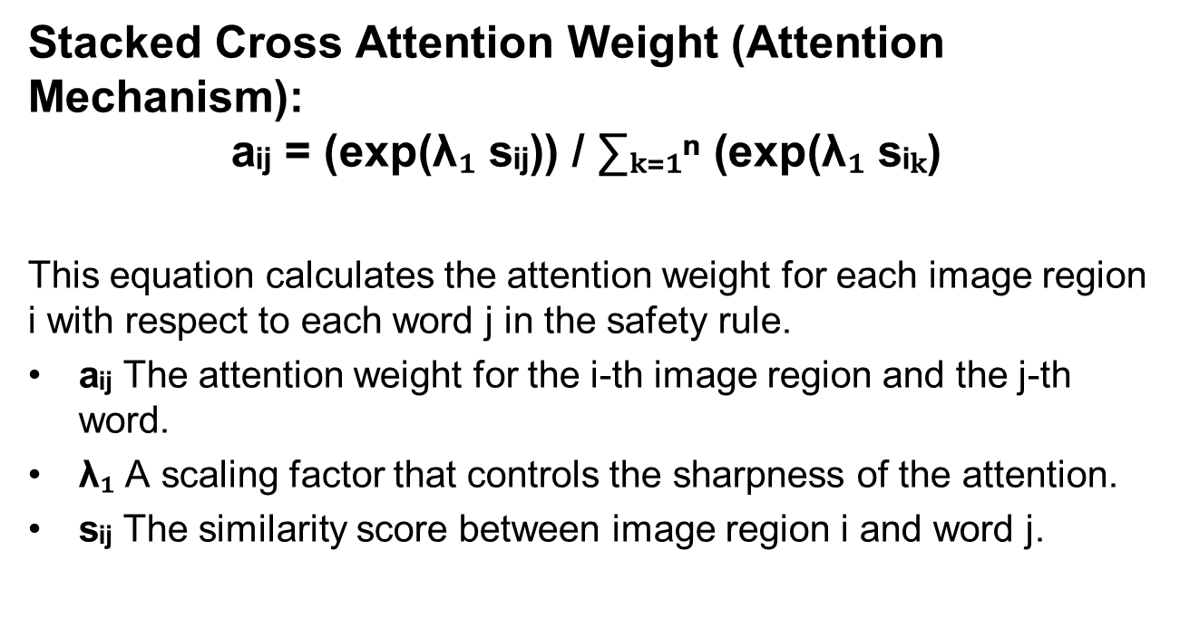
Working ( Contd…)
Stacked Cross Attention Weight (Attention Mechanism):
$$\text{a}\text{ᵢⱼ = (}\text{exp}\text{(}\text{λ}\text{₁ }\text{s}\text{ᵢⱼ)) / ∑ₖ₌₁ⁿ (}\text{exp}\text{(}\text{λ}\text{₁ }\text{s}\text{ᵢₖ) }$$
This equation calculates the attention weight for each image region i with respect to each word j in the safety rule.
aᵢⱼ The attention weight for the i-th image region and the j-th word.
λ₁ A scaling factor that controls the sharpness of the attention.
sᵢⱼ The similarity score between image region i and word j.

Slide 18
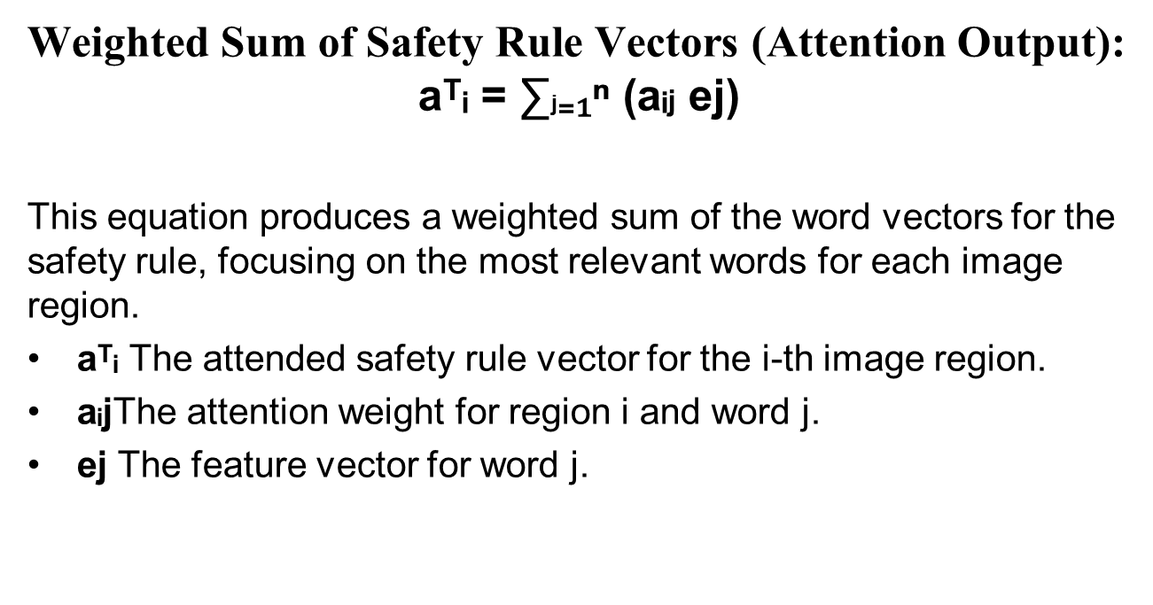
Working ( Contd…)
Weighted Sum of Safety Rule Vectors (Attention Output):
$$\text{a}\text{ᵀᵢ = ∑}\text{j}\text{₌₁ⁿ (}\text{a}\text{ᵢ}\text{j} \text{ej}\text{)}$$
This equation produces a weighted sum of the word vectors for the safety rule, focusing on the most relevant words for each image region.
aᵀᵢ The attended safety rule vector for the i-th image region.
aᵢjThe attention weight for region i and word j.
ej The feature vector for word j.

Slide 19
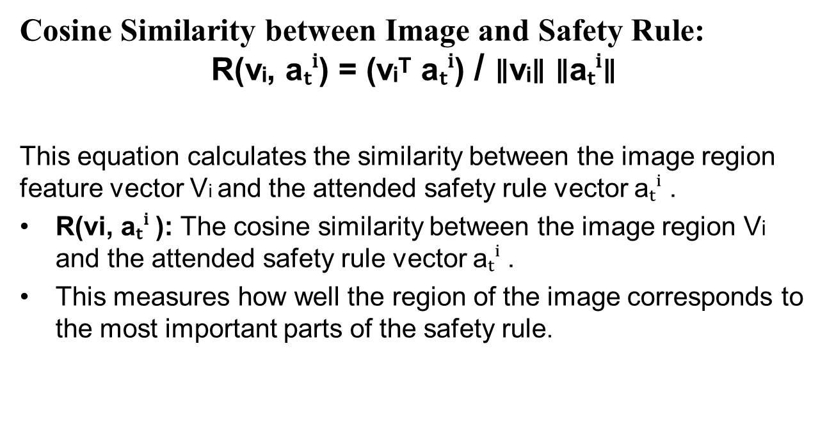
Working ( Contd…)
Cosine Similarity between Image and Safety Rule:
$$\text{R}\text{(}\text{v}\text{ᵢ, }\text{a}\text{ₜⁱ) = (}\text{v}\text{ᵢᵀ }\text{a}\text{ₜⁱ) }\text{/ }\text{∥}\text{v}\text{ᵢ∥ ∥}\text{a}\text{ₜⁱ∥ }$$
This equation calculates the similarity between the image region feature vector Vi​ and the attended safety rule vector aₜⁱ .
R(vi​, aₜⁱ ): The cosine similarity between the image region Vi and the attended safety rule vector aₜⁱ .
This measures how well the region of the image corresponds to the most important parts of the safety rule.

Slide 20
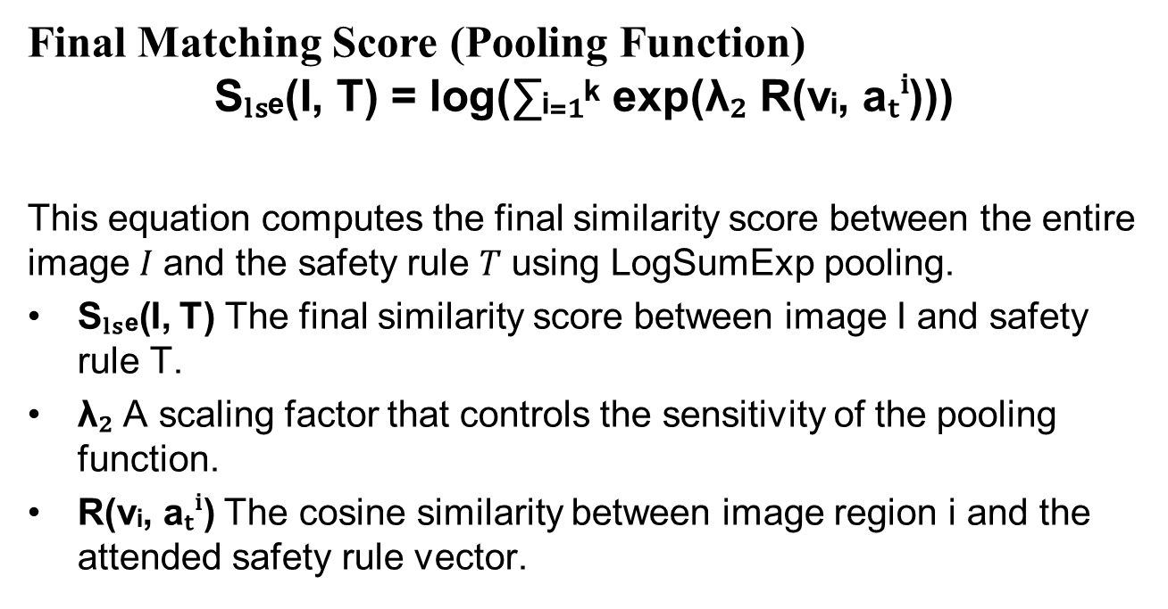
Working ( Contd…)
Final Matching Score (Pooling Function)
$$\text{S}\text{ₗₛₑ(}\text{I}\text{, }\text{T}\text{) = }\text{log}\text{(∑ᵢ₌₁ᵏ }\text{exp}\text{(}\text{λ}\text{₂ }\text{R}\text{(}\text{v}\text{ᵢ, }\text{a}\text{ₜⁱ)))}$$
This equation computes the final similarity score between the entire image 𝐼 and the safety rule 𝑇 using LogSumExp pooling.
Sₗₛₑ(I, T) The final similarity score between image I and safety rule T.
λ₂ A scaling factor that controls the sensitivity of the pooling function.
R(vᵢ, aₜⁱ) The cosine similarity between image region i and the attended safety rule vector.

Slide 21
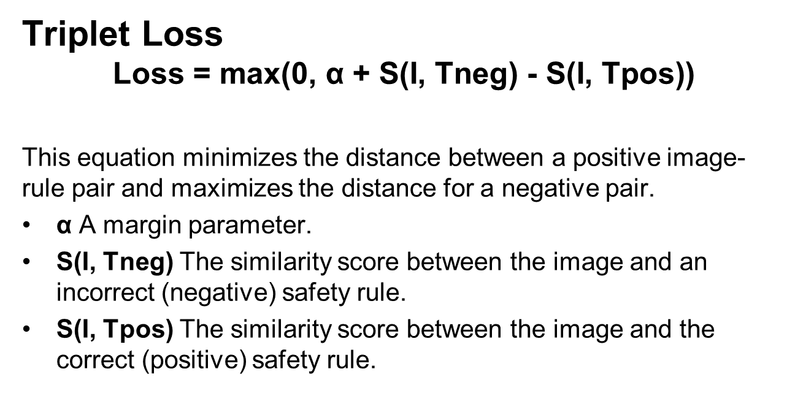
Working ( Contd…)
Triplet Loss
$$\text{Loss}\text{ = }\text{max}\text{(0, }\text{α}\text{ + }\text{S}\text{(}\text{I}\text{, }\text{Tneg}\text{) − }\text{S}\text{(}\text{I}\text{, }\text{Tpos}\text{))}$$
This equation minimizes the distance between a positive image-rule pair and maximizes the distance for a negative pair.
α A margin parameter.
S(I, Tneg) The similarity score between the image and an incorrect (negative) safety rule.
S(I, Tpos) The similarity score between the image and the correct (positive) safety rule.

Slide 22
YOLO - Efficient Small-target and Context Attention
It is an improved version of the YOLOv5 model, designed to detect safety helmet-wearing behavior.
The enhancements include:
EIOU-loss for better bounding box prediction.
Soft-NMS for improved handling of overlapping objects.
CBAM (Convolutional Block Attention Module) for better focus on important regions, especially small targets like helmet straps.
ADL (small-target detection layer) for better performance on small, distant, or occluded object

Slide 23
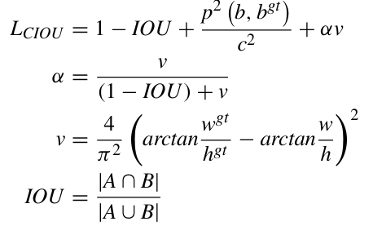
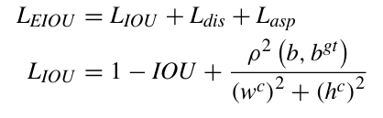
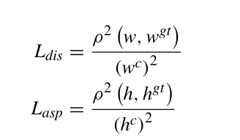
EIOU LOSS

Slide 24
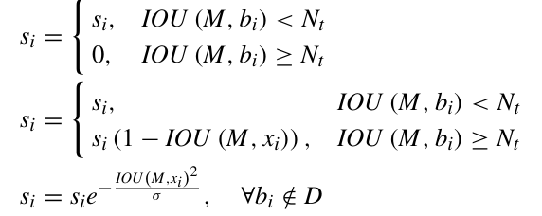
Soft-Non-Maximum Suppression
When object detection models like YOLO output multiple bounding boxes for the same object, NMS is used to:
Keep only the most confident bounding box (i.e., the one with the highest confidence score).
Suppress lower-scoring boxes that have a significant overlap with the most confident one.

Slide 25
CBAM
The Convolutional Block Attention Module (CBAM) is a lightweight attention mechanism designed to capture both the channel and spatial dimensions.
CBAM consists of two sub-modules:
Channel Attention Module (CAM)
Spatial Attention Module (SAM)

Slide 26
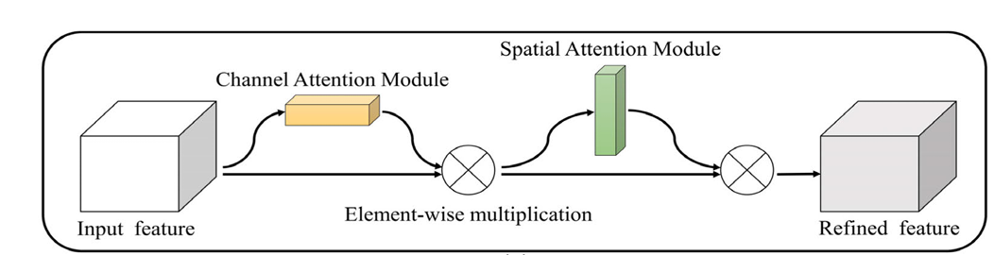
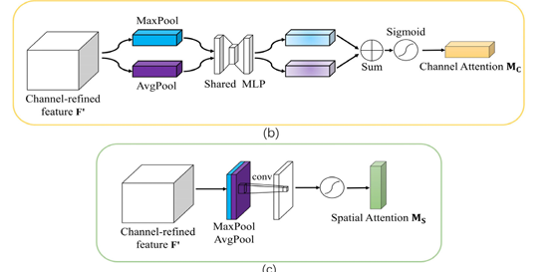
CBAM (Contd…)

Slide 27
Adaptive Detection Layer
ADL plays a critical role in enhancing the detection capabilities of the model for small targets, such as helmet chin straps.
ADL is added as an extra detection layer, which allows the model to better capture fine details at lower resolutions (e.g., 160x160 feature maps).

Slide 28
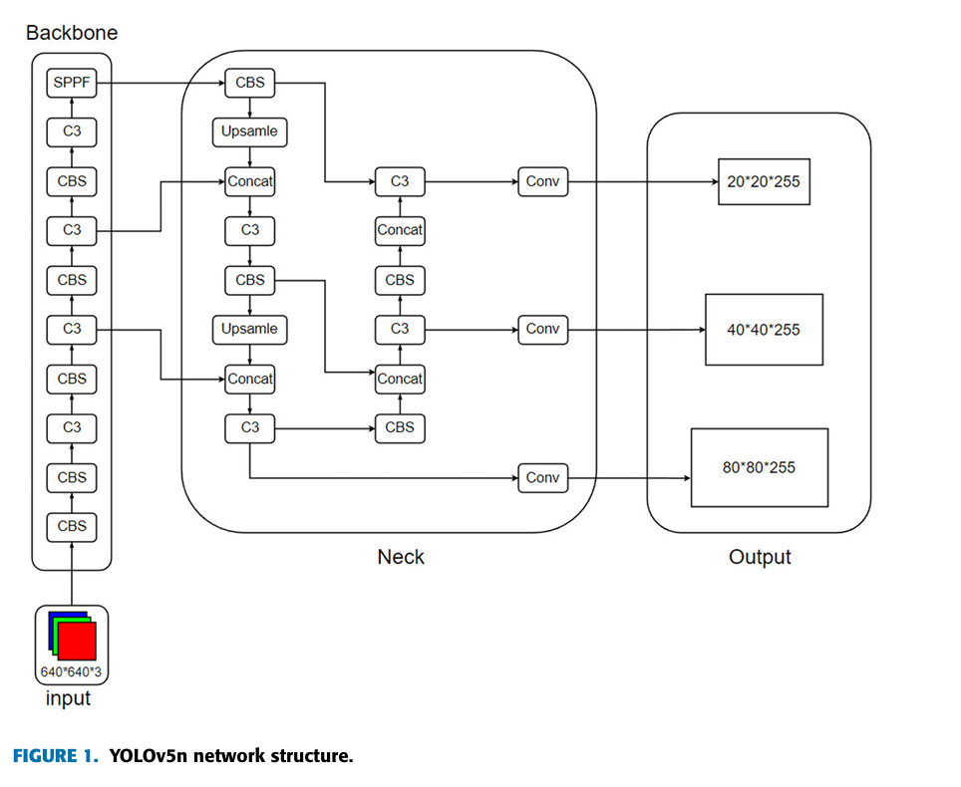
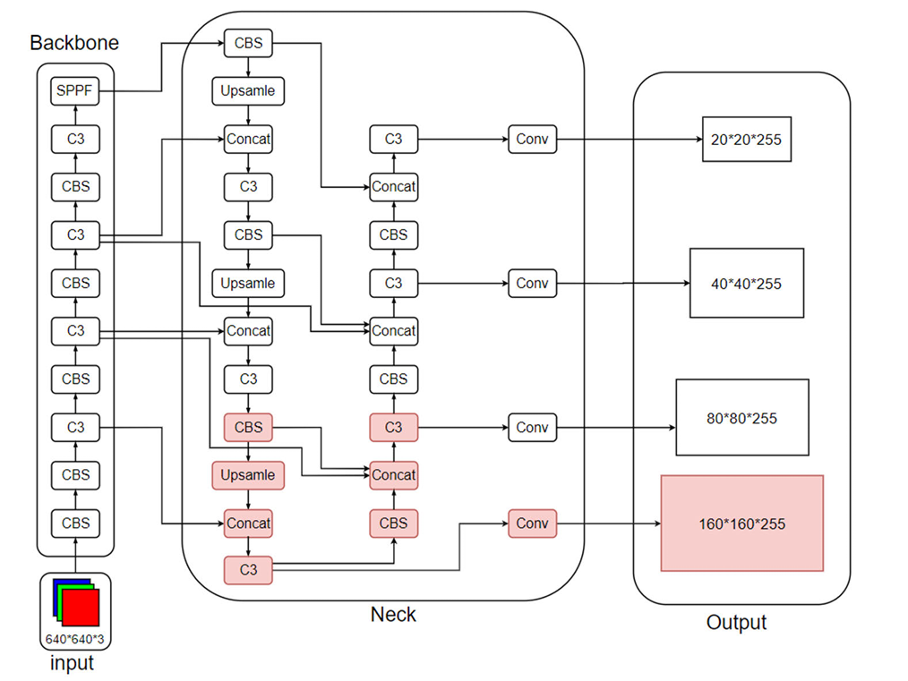
YOLO V5 vs YOLO ESCA
YOLO-V5
YOLO-ESCA

Slide 29
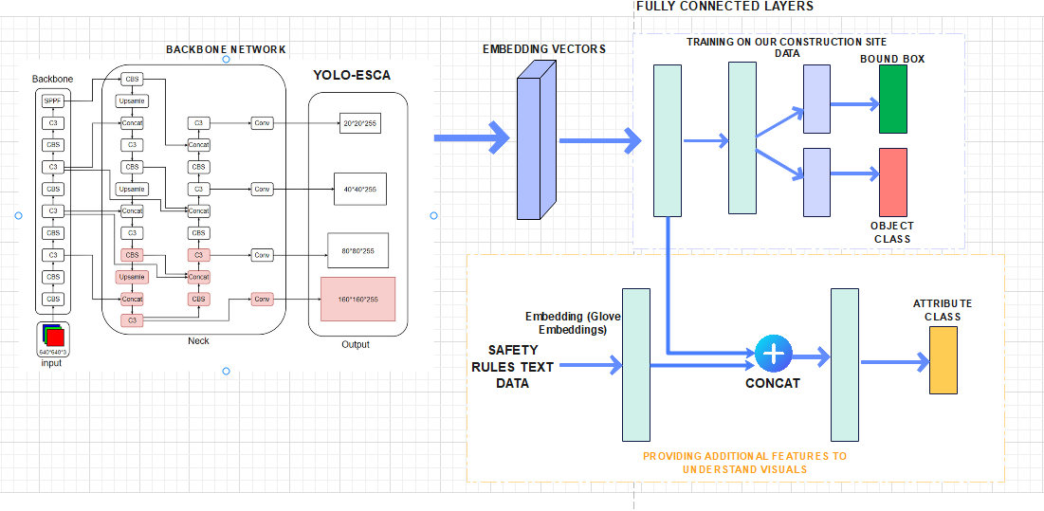
Modified Architecture

Slide 30
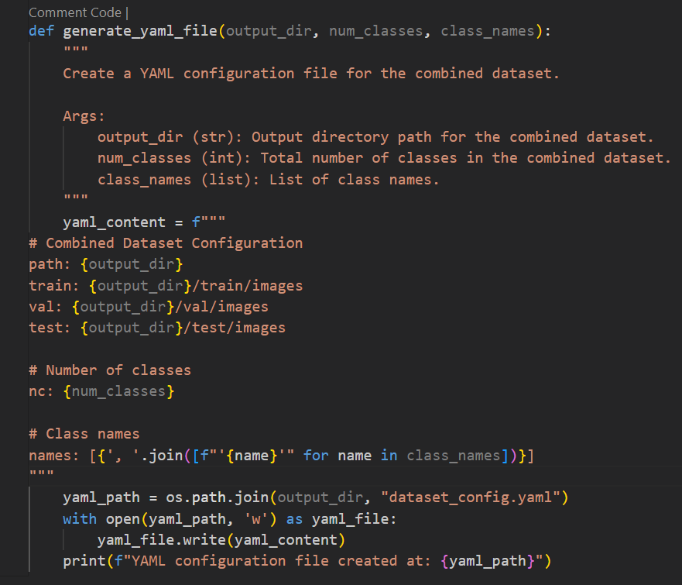
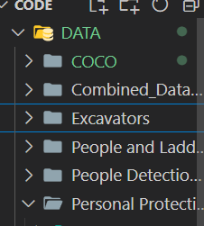
Results
Data Combination
Dataset
YAML file Creation for Meta data

Slide 31
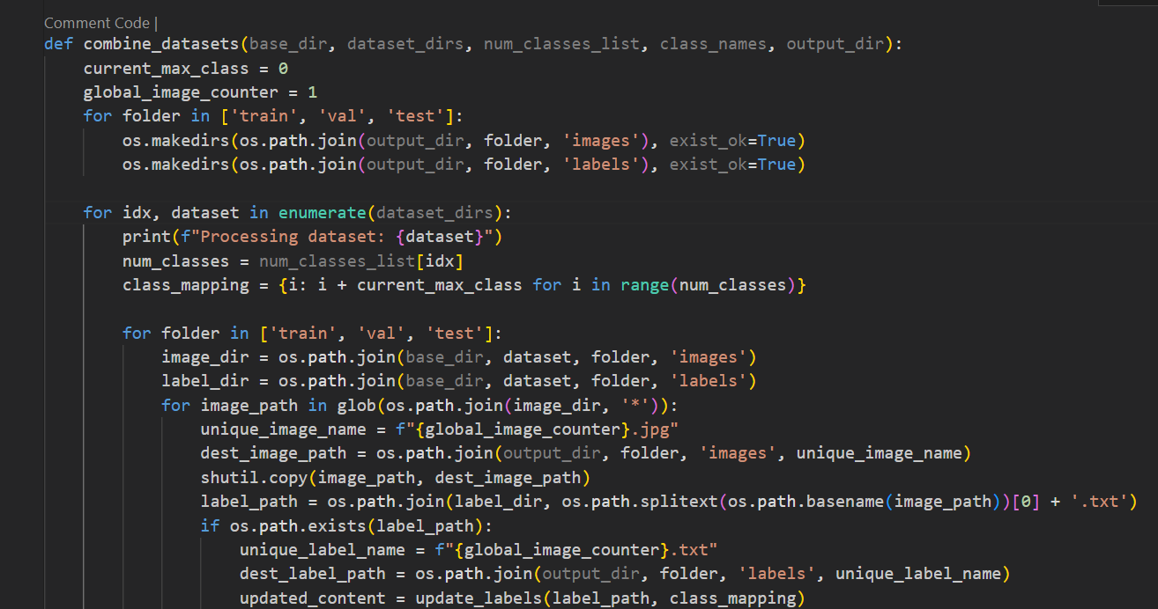
Results
Data Combination (Contd…)
Combining dataset

Slide 32
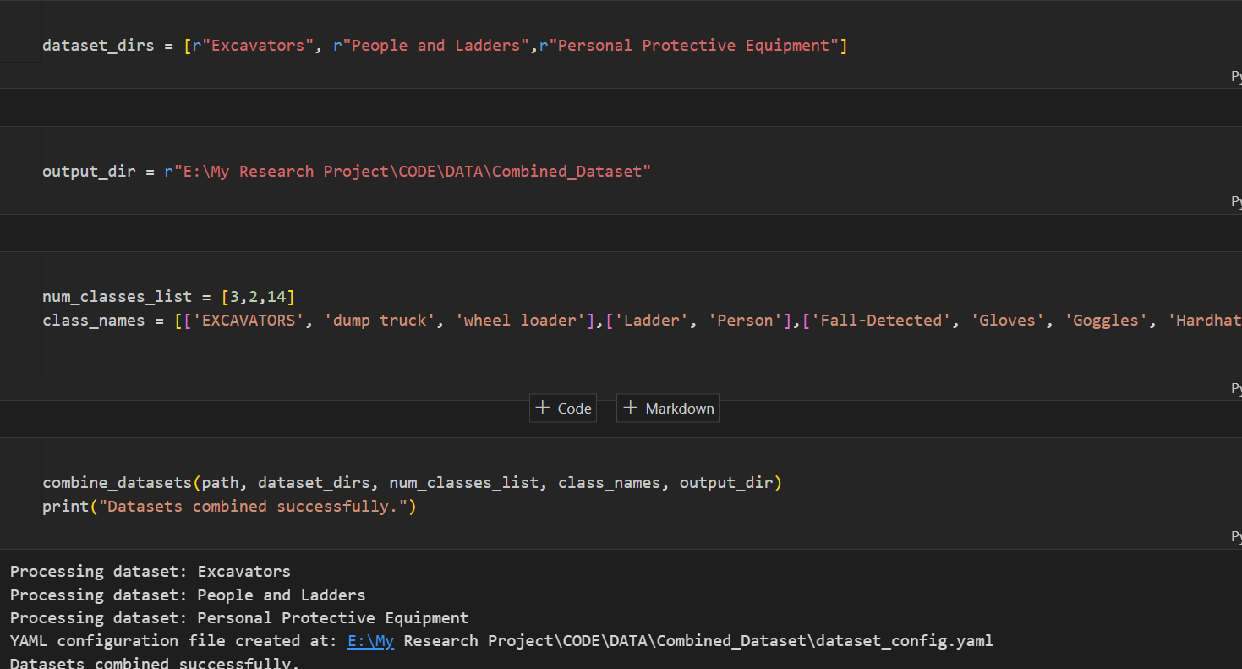
Results
Output of Data Combination

Slide 33
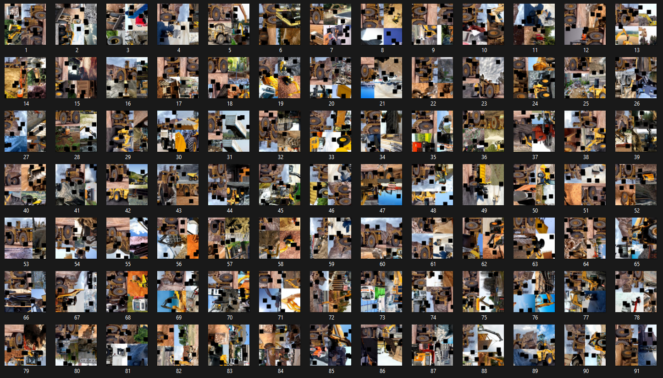
Results
Output of Data Combination

Slide 34
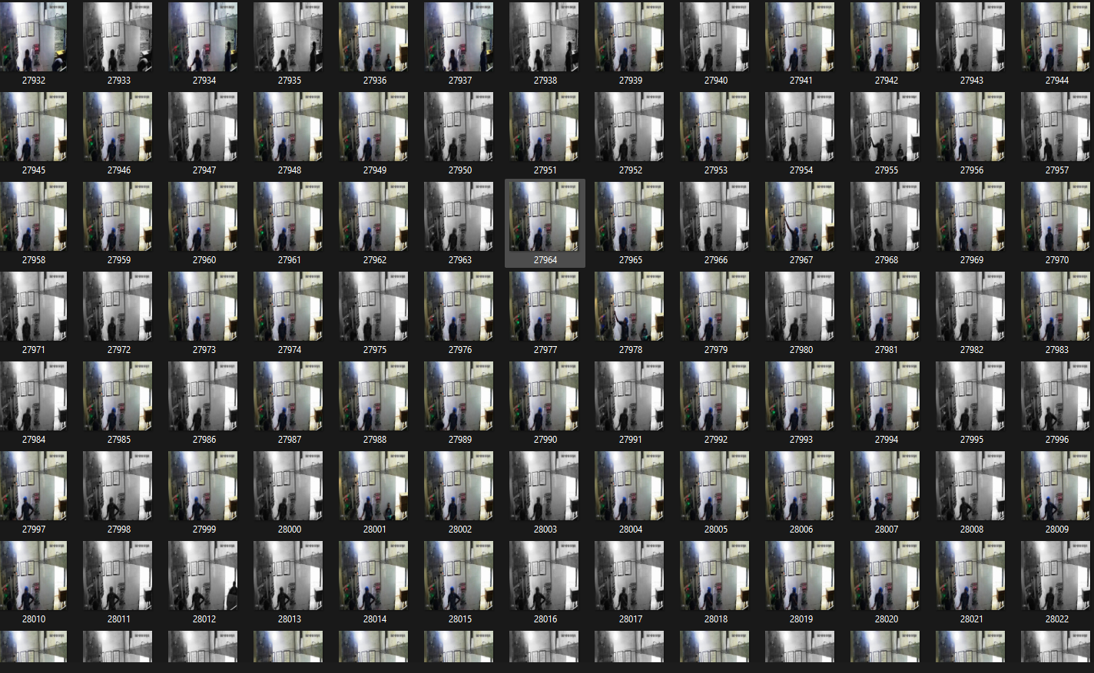
Results
Output of Data Combination

Slide 35
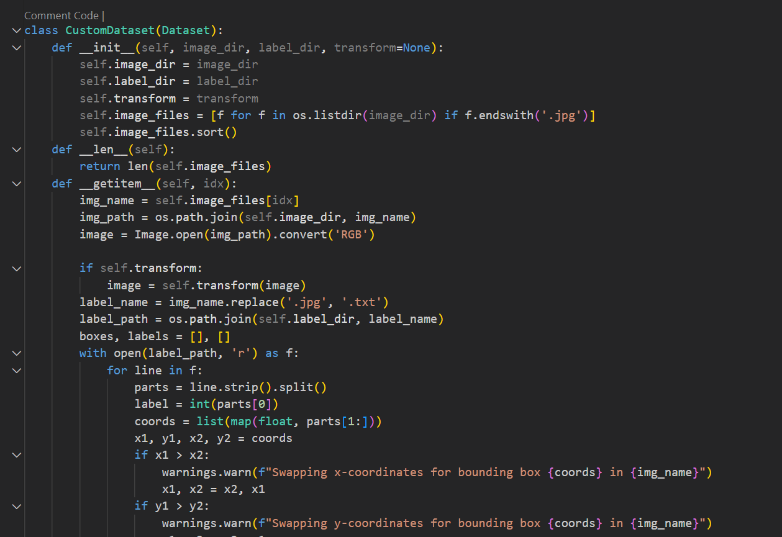
Results
Model Implementation
Custom dataset loading Class

Slide 36
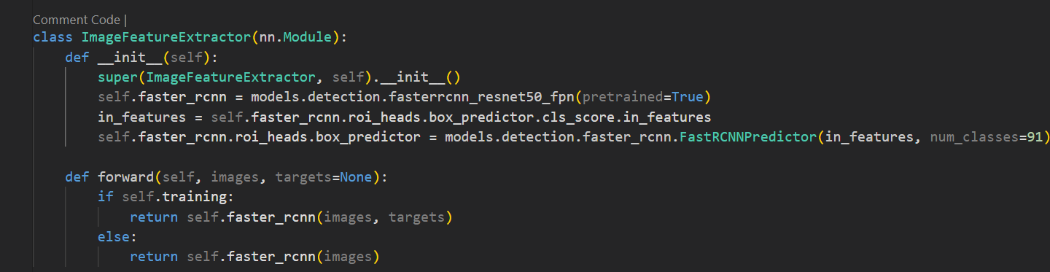
Results
Model Implementation
Back bone network implementation

Slide 37
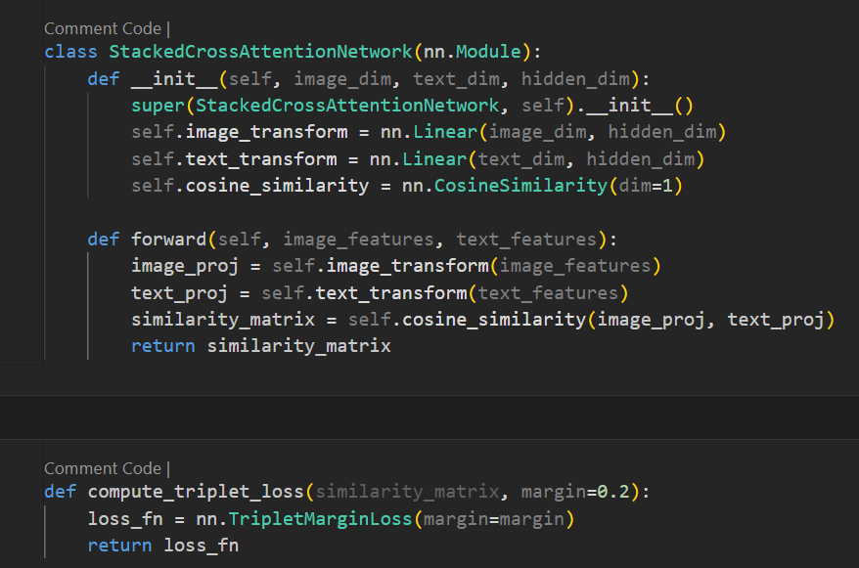
Results
Model Implementation
Stacked Cross attention and TripletLoss

Slide 38
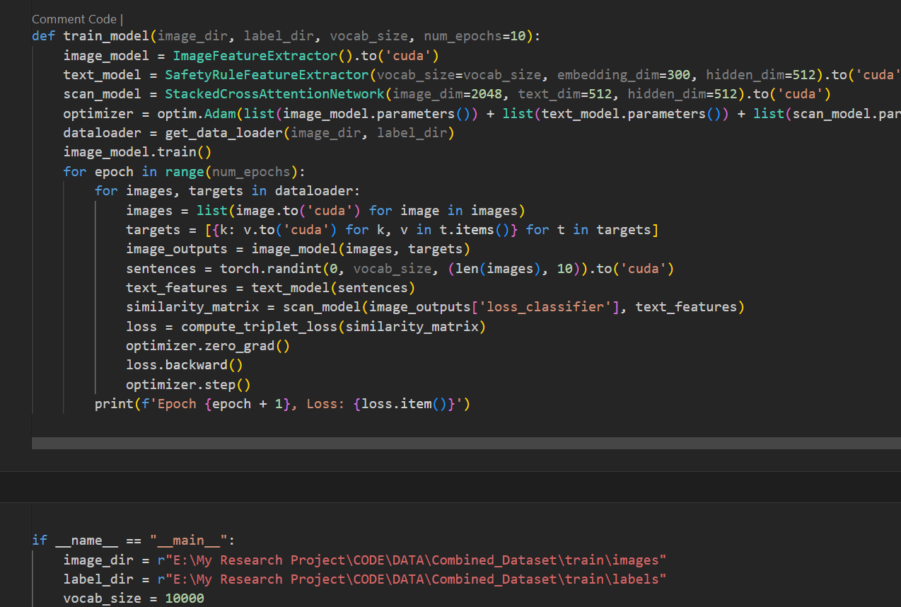
Results
Model Implementation
Model Training

Slide 39
Results
Model Implementation
Model Training

